Slide 1
Image Steganography
Under the guidance of Ms. Lavanya Krishna
By Keerthana Bhat & Heeth M Thakkar

Slide 2
What is Steganography?
Steganography – Greek - ‘stegos’ : to cover ; ‘grayfia’ : writing
Art & Science of embedding information
No one apart from the sender and receiver suspects the existence of the message
Types of Steganography
Image Steganography
Audio Steganography
Video Steganography
Email Steganography
Network Steganography

Slide 3
Steganography vs Cryptography
Steganography | Cryptography
Unknown message passing | Known message passing
Structure of data is same | Structure of data is altered
Little known Technology | Common Technology
Supports Confidentiality & Authentication | In addition to Confidentiality & Authentication, Data integrity & Non-repudiation is supported
Attack – Steganalysis | Attack - Cryptanalysis

Slide 4
Image Steganography
Technique of hiding data within an image
Popular method of hiding information as images have a large number of pixels
Digital images are insensitive to human visual system, therefore act as good cover carriers
Objective
In this project we mainly concentrated on embedding data into an image. The goal of steganography is to communicate securely in a completely undetectable manner and to avoid drawing suspicion to the existence of hidden messages. Many different carrier file formats can be used, but digital images are the most popular because of their frequency on the internet.

Slide 5
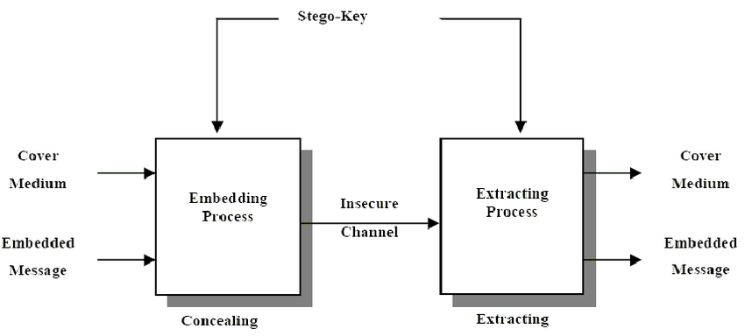

Slide 6
Working
Every colour image pixel - Red, Green & Blue components
Each component - 8bits (0 to 255)
ASCII of each character (8bits) - stored in 1bit (preferably LSB) of each component (R, G, B)
Therefore, each character requires 3 pixels
LSB of 3rd pixel tells whether further information is present or not
Program demonstration
Explanation & execution of the code

Slide 7
Applications
Defence organisations and secret agencies
Intelligence & Government agencies
Smart identity cards
Medical information
Conclusion
Security is an important issue while transferring data using internet because any unauthorized individual can hack the data. Therefore Steganography can be used for secret data exchange.
The speed of embedding the data into an image is high in the proposed approach as it includes simple calculations.
This project can be enhanced by
Improving image to text compression ratio
Supporting multiple file formats

